Slide 1
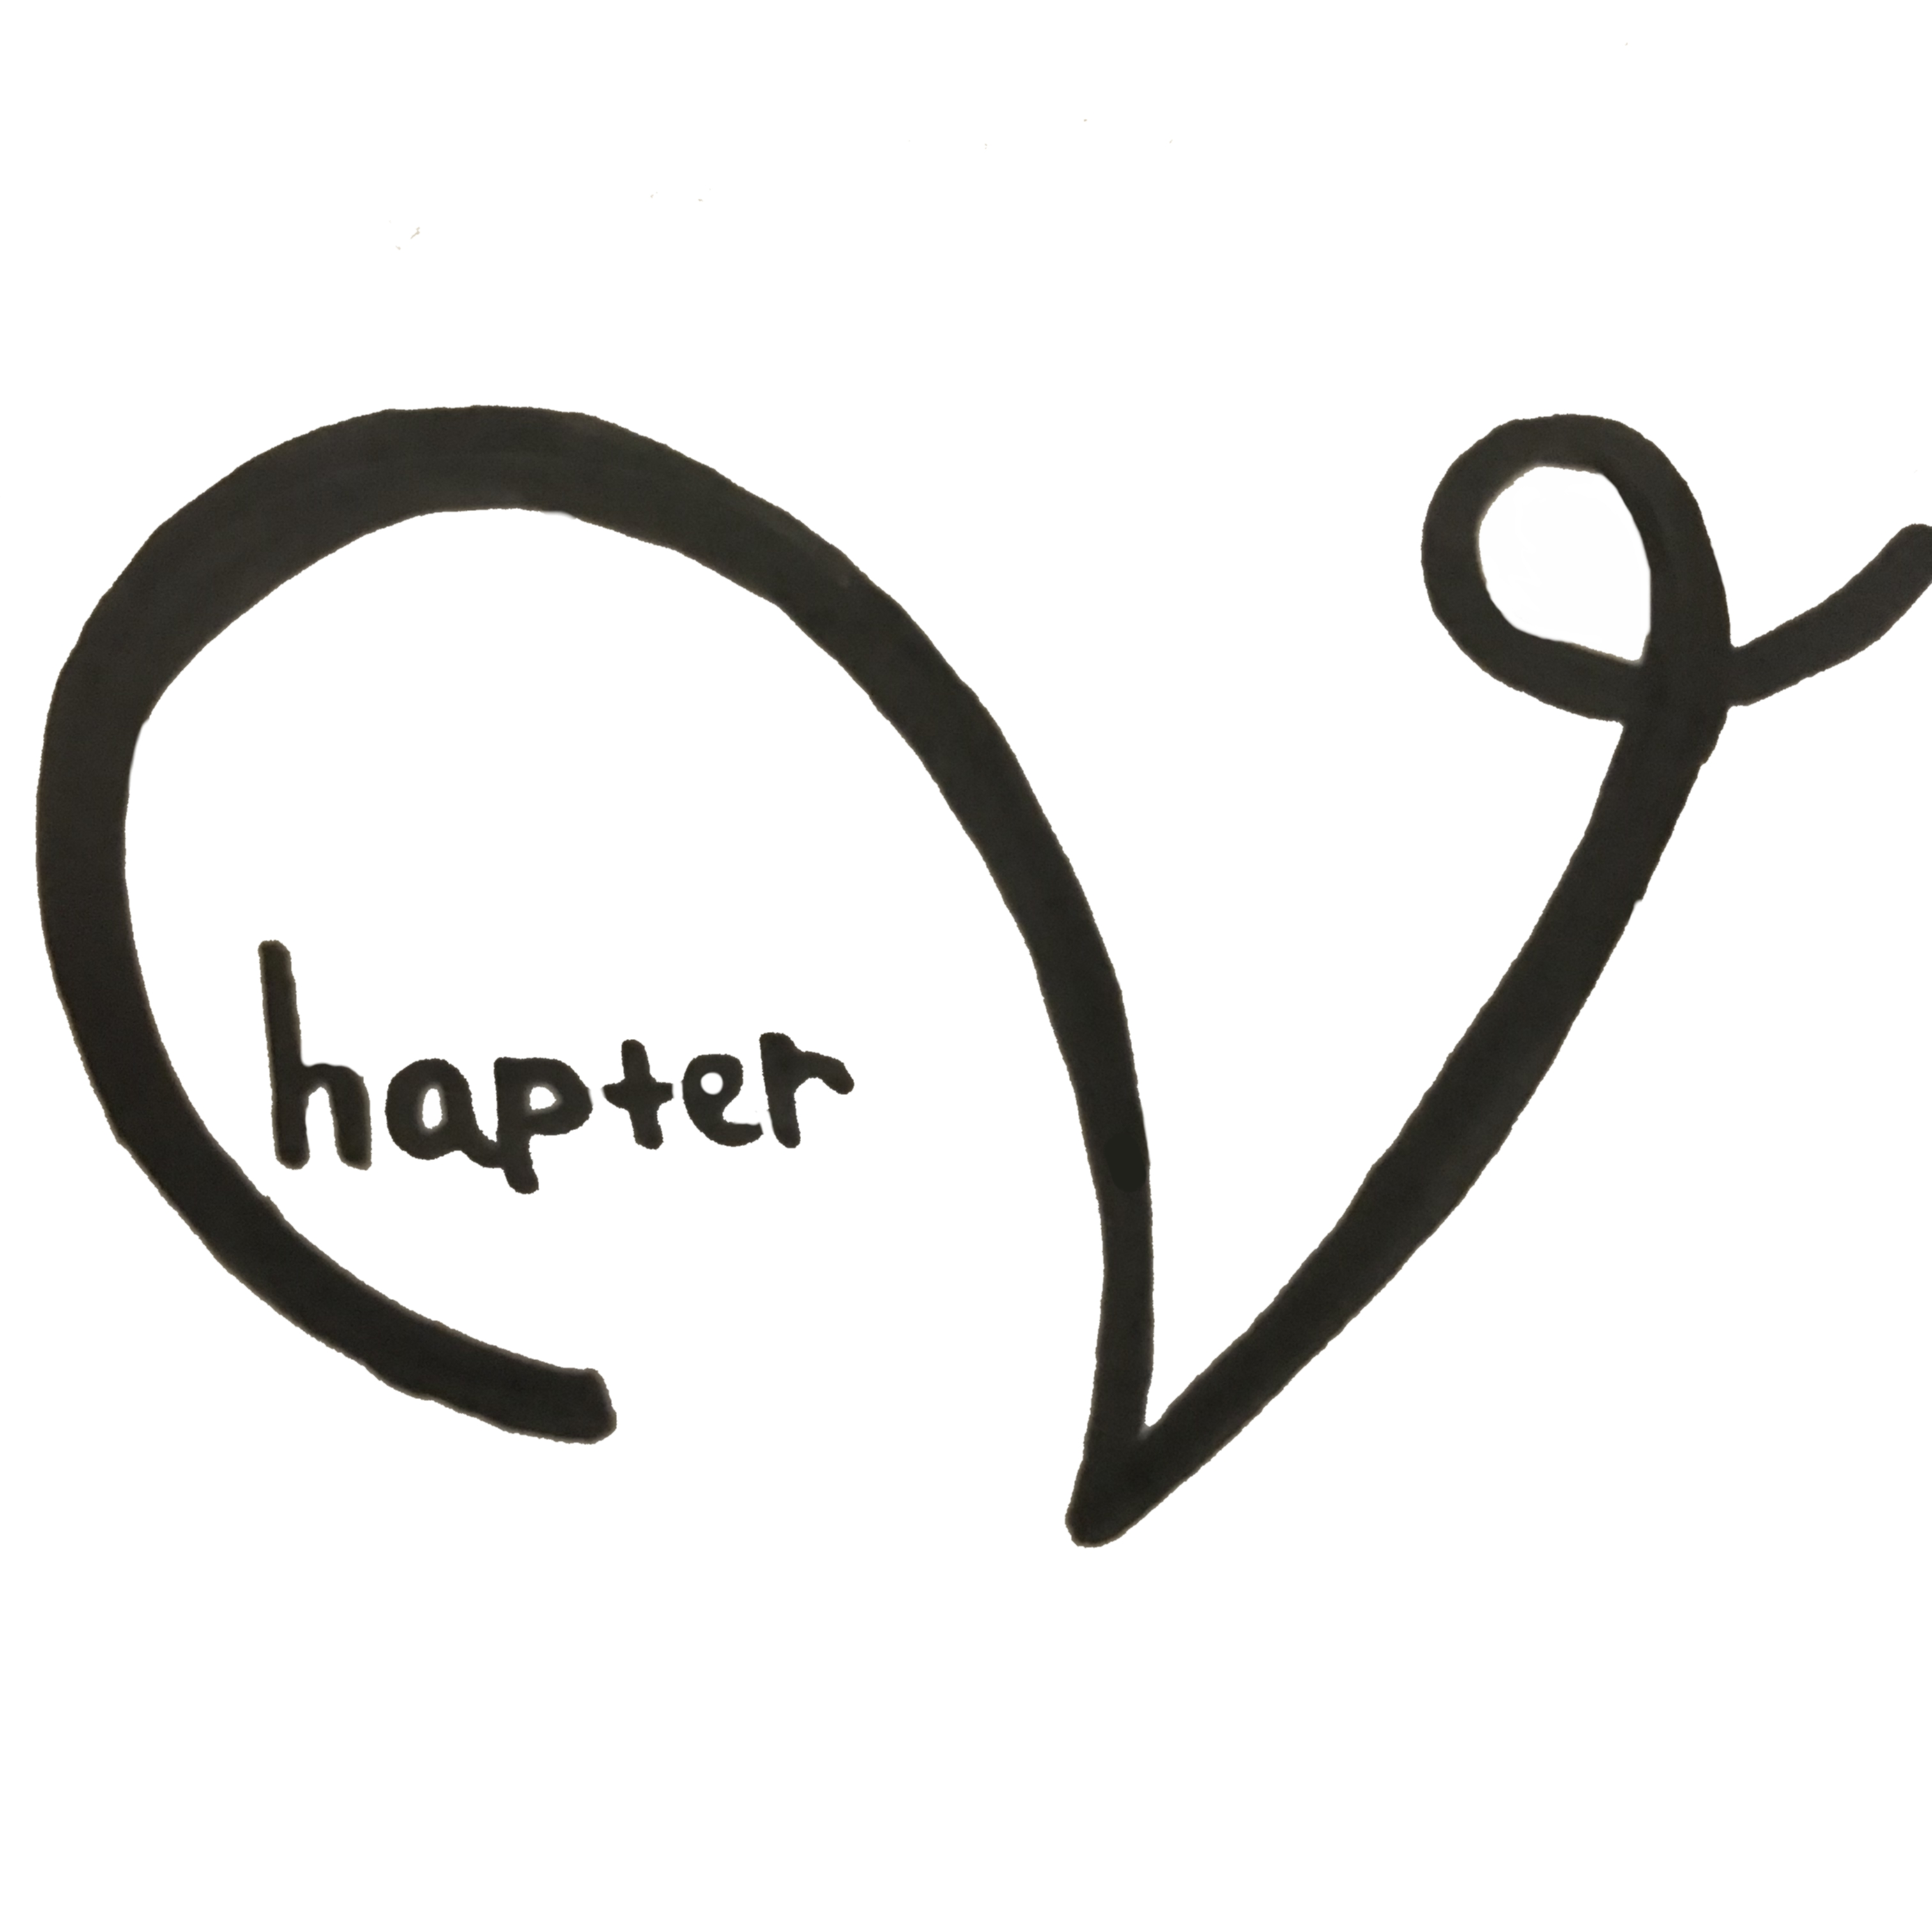
Simple Visuals of Learning Science
By:
Stacia Johanna

Slide 2
Background
Problem:
Some school topics require students to remember particular steps, structures, or complex information.
However, sometimes teachers/students learn the steps simply by memorizing the narrative -> bad for long-term + not fun
Solution:
Visualization!
Notes:
Visualization helps teacher in explaining the process/complicated topics.
Having simple sketches, if done right, can benefit the students

Slide 3
Learning Outcomes
Learn to visualize hard-to-draw topics
Experience that visualization is effective for learning, and hopefully will be implemented by teachers in class
Side Goal: Gain new knowledge/review about learning science phrases

Slide 4
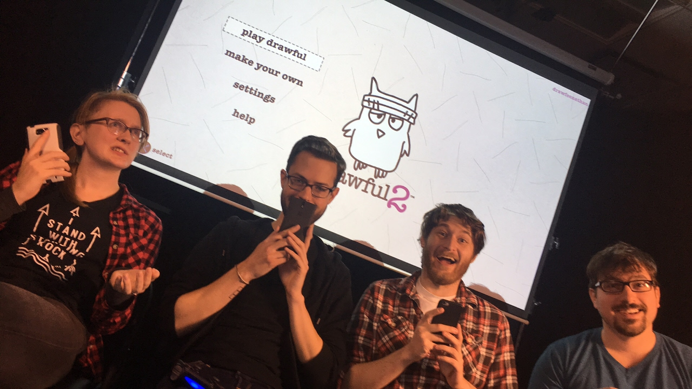
About Chapter V…
Format: Semi-Digital
Keywords: Drawing and Discuss
Key Game Mechanics: Really Bad Art (drawing game) and Jackbox Game
Notes:
Semi-Digital: papers & pencils, phones, and 1 laptop/PC

Slide 5
Game Overview
All players have to draw the topics they received in their phones within a certain amount of time, then guess the others’ drawings to get points

Slide 6
Summarized Gameplay
DRAW based on the topics given in each player’s smartphones.
MATCH other players’ drawings with the prompts.
LEARN the topics’ descriptions together while revealing the answers.
DISCUSS and decide which parts of the drawing are necessary/unnecessary features.
Repeat and WIN the game by getting ≥ 45 points!

Slide 7
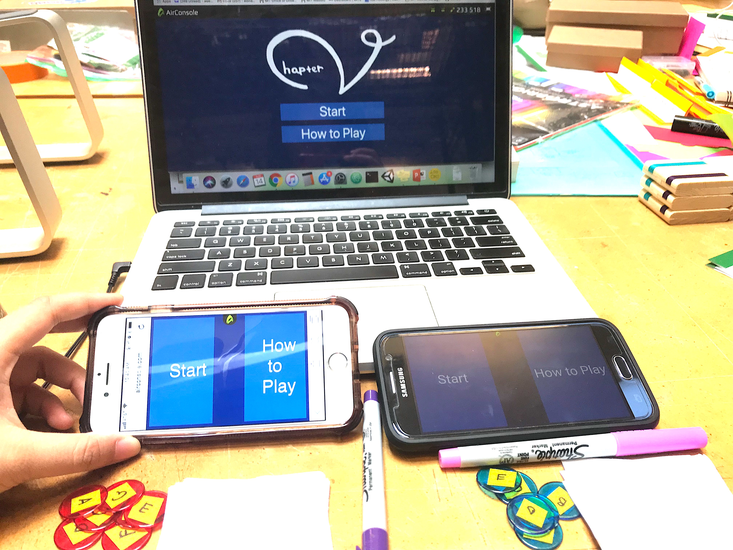

Slide 8
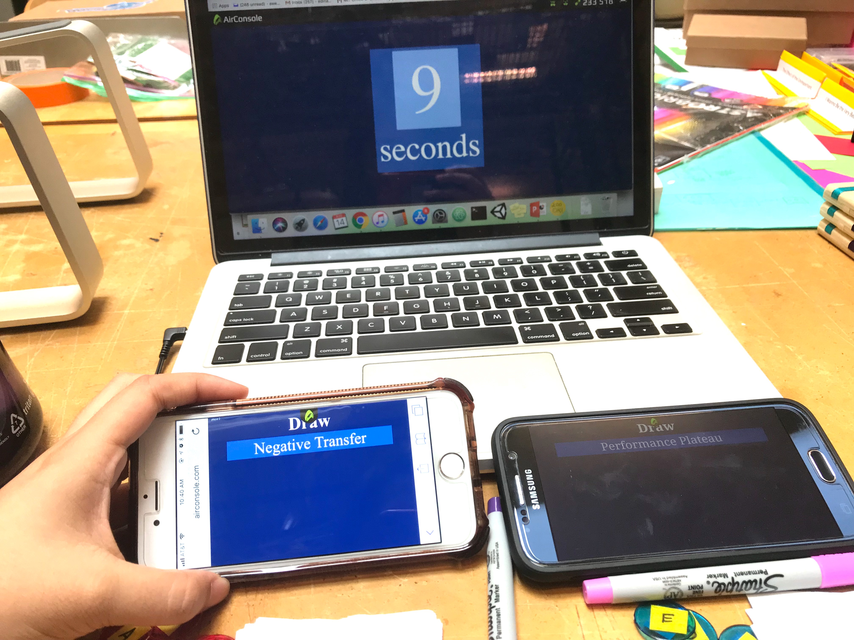
Step 1: Draw!

Slide 9
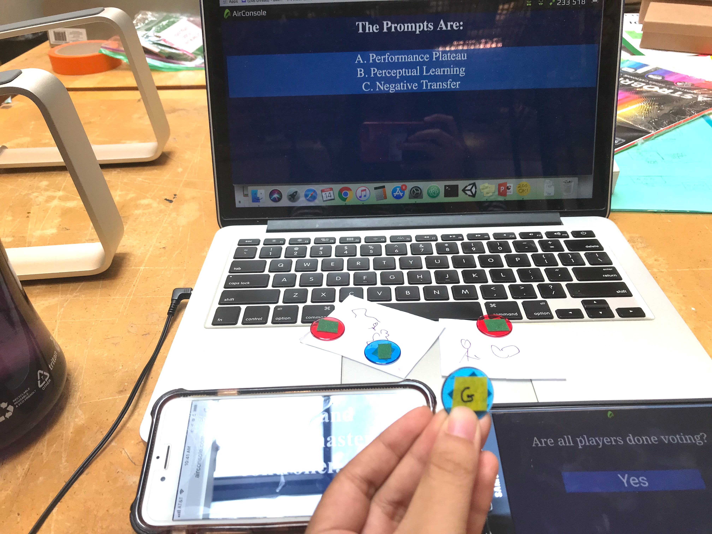
Step 2: Match!
B

Slide 10
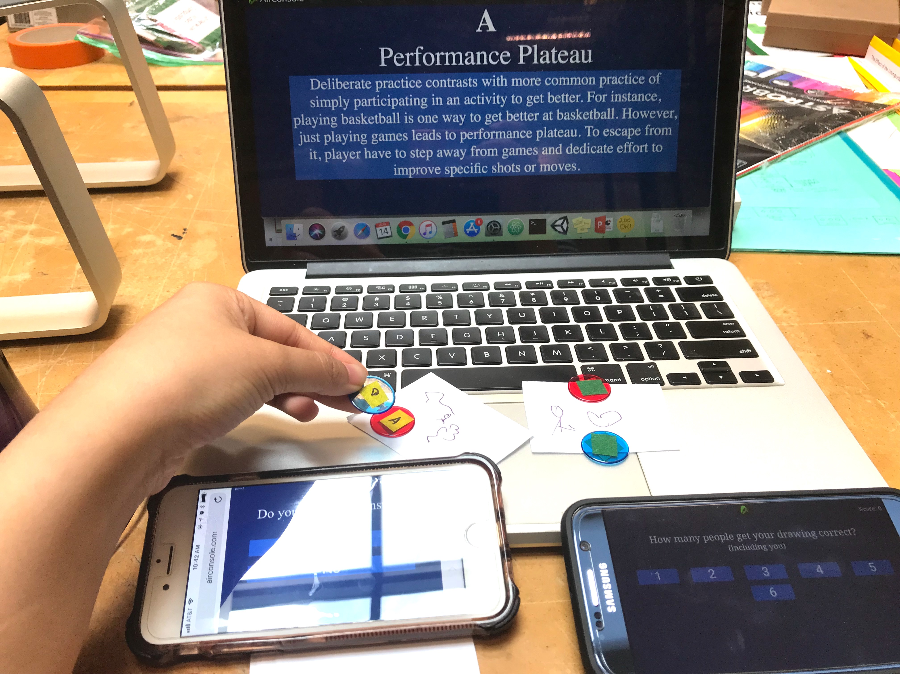
Step 3: Learn and Reveal!

Slide 11
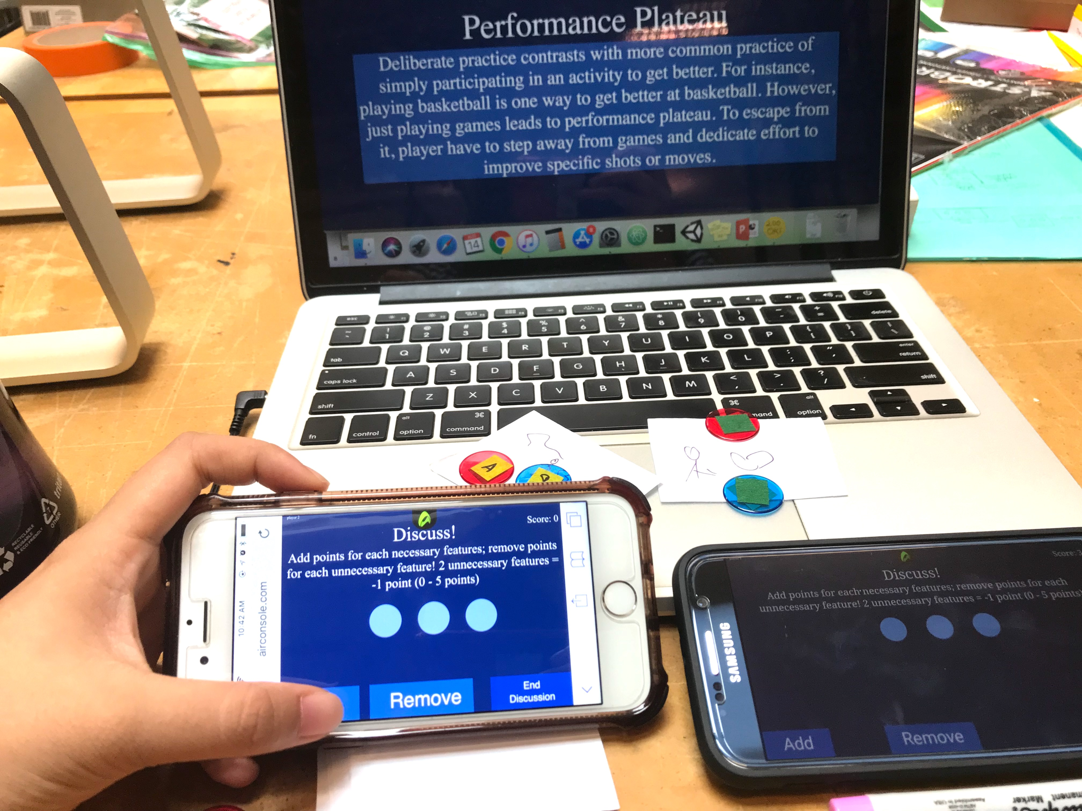
Step 4: Discuss!

Slide 12
Result and Changes from Playtests
People not talking to each other → Add the discussion step to encourage more interaction
(During paper prototype) Too many components → Convert some parts into digital
Players don’t know what to draw because of unfamiliar topics → Make 2 versions of the game:
Chapter V: Begin → Longer drawing time (1 minute), and display both topics and descriptions during drawing steps. Used for learning the phrases
Re: Chapter V → Time crunch (10 seconds), and display only the topics. Used for reviewing the words/for players who already read the ABCs book
Notes:
Progress to goal: playing both version will be helpful for teachers see the progress of their knowledge, esp in Re: Chapter V

Slide 13
Strengths and Shortcomings
Strengths:
Discussion step
Semi-Digital
Easily Customizable!
Shortcomings:
Difficult initial set up
(currently) have a very simple/bad visual
Notes:
Discussion step: encourage ppl to remember the phrases and learn what’s important in visualization
Digital: will be new experience for some people to play Jackbox type game
Easy customization: prompts, time, max points
Initial set up: learning curve

Slide 14
Future Development
Technical:
Makes it fully digital
Design better layout
Deploy it to AirConsole website to make the initial set-up simpler
Prompts:
Add more prompts (outside of ABCs book) that relates to learning science

Slide 15
Summer UROP Experience
Personal comments
Some feedbacks
Notes:
Personal comment: Fun! Like the personal research + project vibes but still supervised with mentors. Learn how to build games from scratch, the design process, and in the dev process I also learn about js and airconsole. Nice to have weekly playtest to get regular feedback
Feedbacks: In the early part of the job, it’ll be nice if we can start working sooner, since there’s already a gap between end of semester and start of work.

